Slide 1

SE321
Lecture 2: Hyper Text Transfer Protocol (HTTP)
SK. Fazlee Rabby
Lecturer
Department of Software Engineering
Daffodil International University

Slide 2
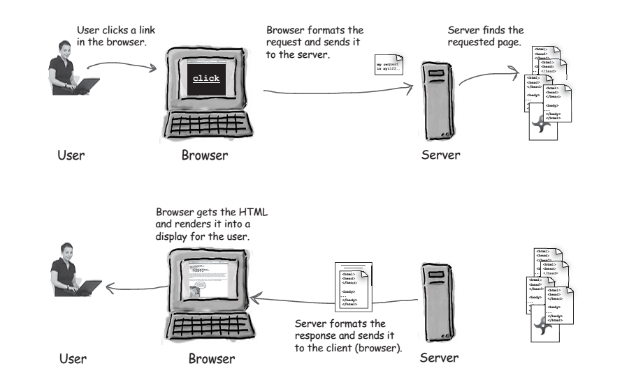
Web Requests

Slide 3
Anatomy of a Webpage
Webpage consists of Objects. Objects can be HTML File, Images, Media etc.
HTML File may also includes several referenced objects. Each object is addressable by a URL.
URL Looks Like: www.somewebsite.com/somecategory/pic.jpeg
Host Name
Path Name

Slide 4
Anatomy of a URL
Protocol: Tells the server which communication protocols will be used (Here HTTP Protocol)
Port: Optional. A web application runs on a port in web server and identified by that port. Port 80 is the default port
Resources: Name of the resource being requested. Could be an HTML Page, a PHP Scripts, Image, PDF, Music or anything else. Default is index.html
http://www.myfavweb.com:80/category/subcategory/product.html
Server: The unique name of the physical server you are looking for. This name maps to a unique IP address. Here we can use IP address but server name are easier to remember
Path: The path to the location of the resource being request on the server

Slide 5




HTTP Overview
Client initiates TCP connection to server over port 80
HTTP uses TCP Connection.
HTTP is Stateless. Protocols that maintain “state” are complex!
past history (state) must be maintained
Server Accepts TCP Connection from Client
HTTP messages exchanged between browser (HTTP client) and Web server (HTTP server)
TCP Connection
Closed

Slide 6
HTTP Connections
Non-Persistent HTTP | Persistent HTTP
At most one object is sent over a TCP connection | Multiple objects can be sent over a single TCP Connection
HTTP/1.0 uses Non-Persistent HTTP | HTTP/1.1 uses persistent connection in default mode

Slide 7
NON-PERSISTENT HTTP
Suppose user enters URL: www.someSchool.edu/someDepartment/home.index
(contains text, references to 10 jpeg images)
1a. HTTP client initiates TCP connection to HTTP server (process) at www.someSchool.edu on port 80
1b. HTTP server at host www.someSchool.edu waiting for TCP connection at port 80. “accepts” connection, notifying client
2. HTTP client sends HTTP request message (containing URL) into TCP connection socket. Message indicates that client wants object someDepartment/home.index
3. HTTP server receives request message, forms response message containing requested object, and sends message into its socket
5. HTTP client receives response message containing html file, displays html. Parsing html file, finds 10 referenced jpeg objects
4. HTTP server closes TCP connection.
6. Steps 1-5 repeated for each of 10 jpeg objects

Slide 8
RESPONSE TIME MODELING
Definition of RTT: time to send a small packet to travel from client to server and back.
Response time:
one RTT to initiate TCP connection
one RTT for HTTP request and first few bytes of HTTP response to return
File Transmission Time
Total = 2RTT+transmit time
Initiate TCP Connection
RTT
Request File
RTT
Time to Transmit File
File Received

Slide 9
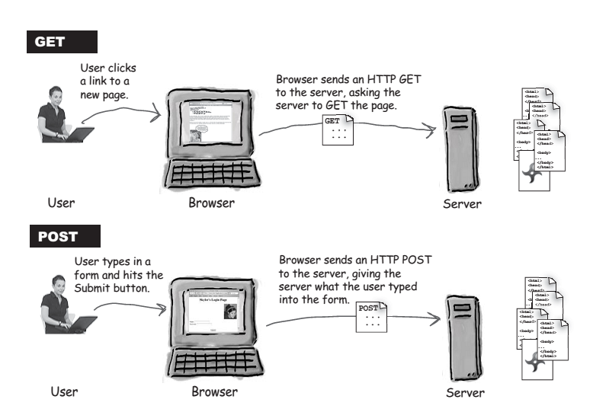
HTTP REQUEST

Slide 10
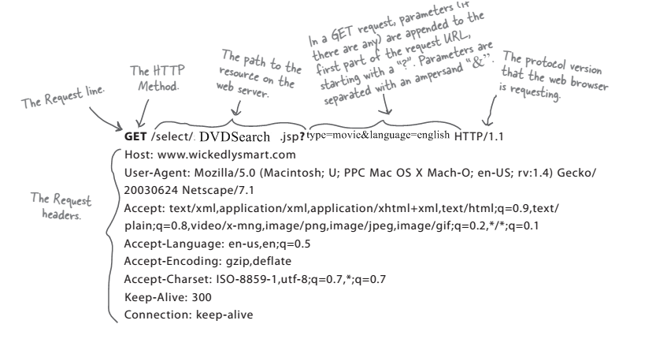
HTTP GET REQUEST

Slide 11
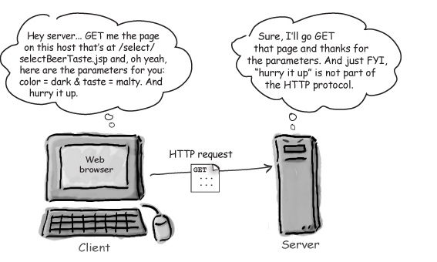
HTTP GET REQUEST

Slide 12
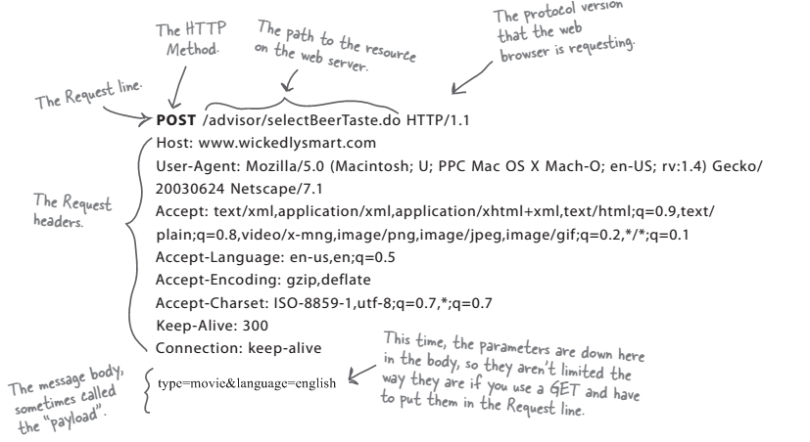
HTTP POST REQUEST

Slide 13
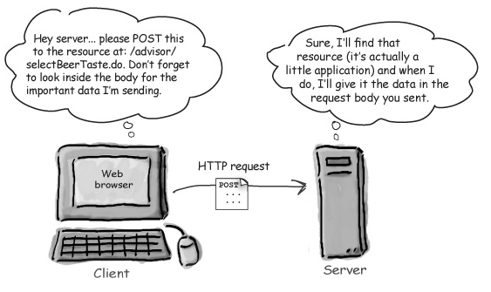

Slide 14
HTTP METHOD TYPES
HTTP/1.0 | HTTP/1.1
GET | GET
POST | POST
HEAD | HEAD
 | PUT
 | DELETE

Slide 15
HTTP RESPONSE MESSAGE
status line
(protocol
status code
status phrase)
HTTP/1.1 200 OK
Connection close
Date: Thu, 06 Aug 1998 12:00:15 GMT
Server: Apache/1.3.0 (Unix)
Last-Modified: Mon, 22 Jun 1998 …...
Content-Length: 6821
Content-Type: text/html
data data data data data ...
header
lines
data, e.g.,
requested
HTML file

Slide 16
HTTP RESPONSE STATUS CODE
200 OK
request succeeded, requested object later in this message
301 Moved Permanently
requested object moved, new location specified later in this message (Location:)
400 Bad Request
request message not understood by server
404 Not Found
requested document not found on this server
505 HTTP Version Not Supported

Slide 17
USER-SERVER INTERACTION
HTTP is Stateless
But What If We Want to Identify Our Users?

Slide 18
AUTHENTICATION
Authentication is the process of verifying the identity of a user by means of a username & password. It is Usually done before authorization.
Example: Employees in a company are required to authenticate through the network before accessing their company email.
401 Unauthorized - There's a problem with 401 Unauthorized, the HTTP status code for authentication errors. And that’s just it: it’s for authentication, not authorization. Receiving a 401 response is the server telling you, “you aren’t authenticated–either not authenticated at all or authenticated incorrectly–but please reauthenticate and try again.” This is a response generally returned by your web server, not your web application. It’s also something very temporary; the server is asking you to try again.

Slide 19

COOKIES
You are visiting Amazon website for shopping.
Usual HTTP Request without Cookies
Server could not identify the user. Generates a new Cookie for this user
Server Replies with Response and a
You added some products to shopping cart. But you needed to leave the website because of your class
Your added product list in HTTP Request
Server identifies you using your cookie and save your cart list in your cookie and.
Server Replies with Response
Amazon = 2012
You are visiting Amazon website after 15 days.
Usual HTTP Request with Cookies
Server identify the user. Using cookies and updates his shopping cart.
Server Replies with Response and updated
Shopping Cart
Amazon = 2012

